Slide 1

FUTURESoftware
Consultancy
Forensics
Development
Products
FUTURESoftware Sales
FUTURESoftware

Slide 2

FUTURESoftware – The Art of Digital Writing
UK Based
Global reach
Delivering innovative solutions for education, AV and enterprise sectors
Business partnerships with HP, Intel, leading LED vendors and AV Integrators
Strategic guidance for AV integration projects
Tailored solutions for education, corporate, healthcare and government clients
FUTURESoftware

Slide 3
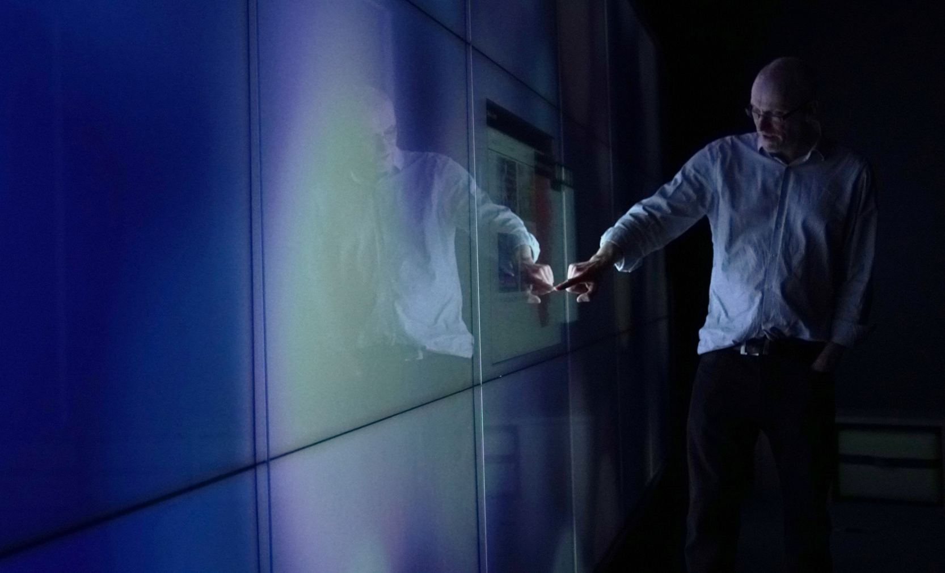
FUTURESoftware – OUR Mission
MISSION
We are committed to understanding our clients' needs and delivering tailored technology solutions. By listening attentively and applying our technical skills, we create innovative software that meets or exceeds client requirements.
VISION
To be a leading provider of innovative technology solutions, empowering businesses to achieve their goals through tailored software development and exceptional client service. While using the right tools that meet the vision without being overly reliant on unsustainable technology.
VALUES
We foster strong, collaborative relationships with our clients and team members, thus bringing unique selling points to client projects. The value proposition must present a clear position compared to the market and competing alternatives.
FUTURESoftware

Slide 4







FUTURESoftware – WHO WE are
A GLOBAL VIEW
With a global perspective and a proven track record, FUTURESoftware delivers exceptional software engineering services. Our dedicated team is committed to exceeding client expectations, no matter the project's location or size.
SOME OF OUR CLIENTS
As a privately funded company, we offer a unique perspective, developing innovative software solutions and fostering strong partnerships with our clients.
Our clients value their anonymity, our approach and majority are repeat clients.
FUTURESoftware

Slide 5

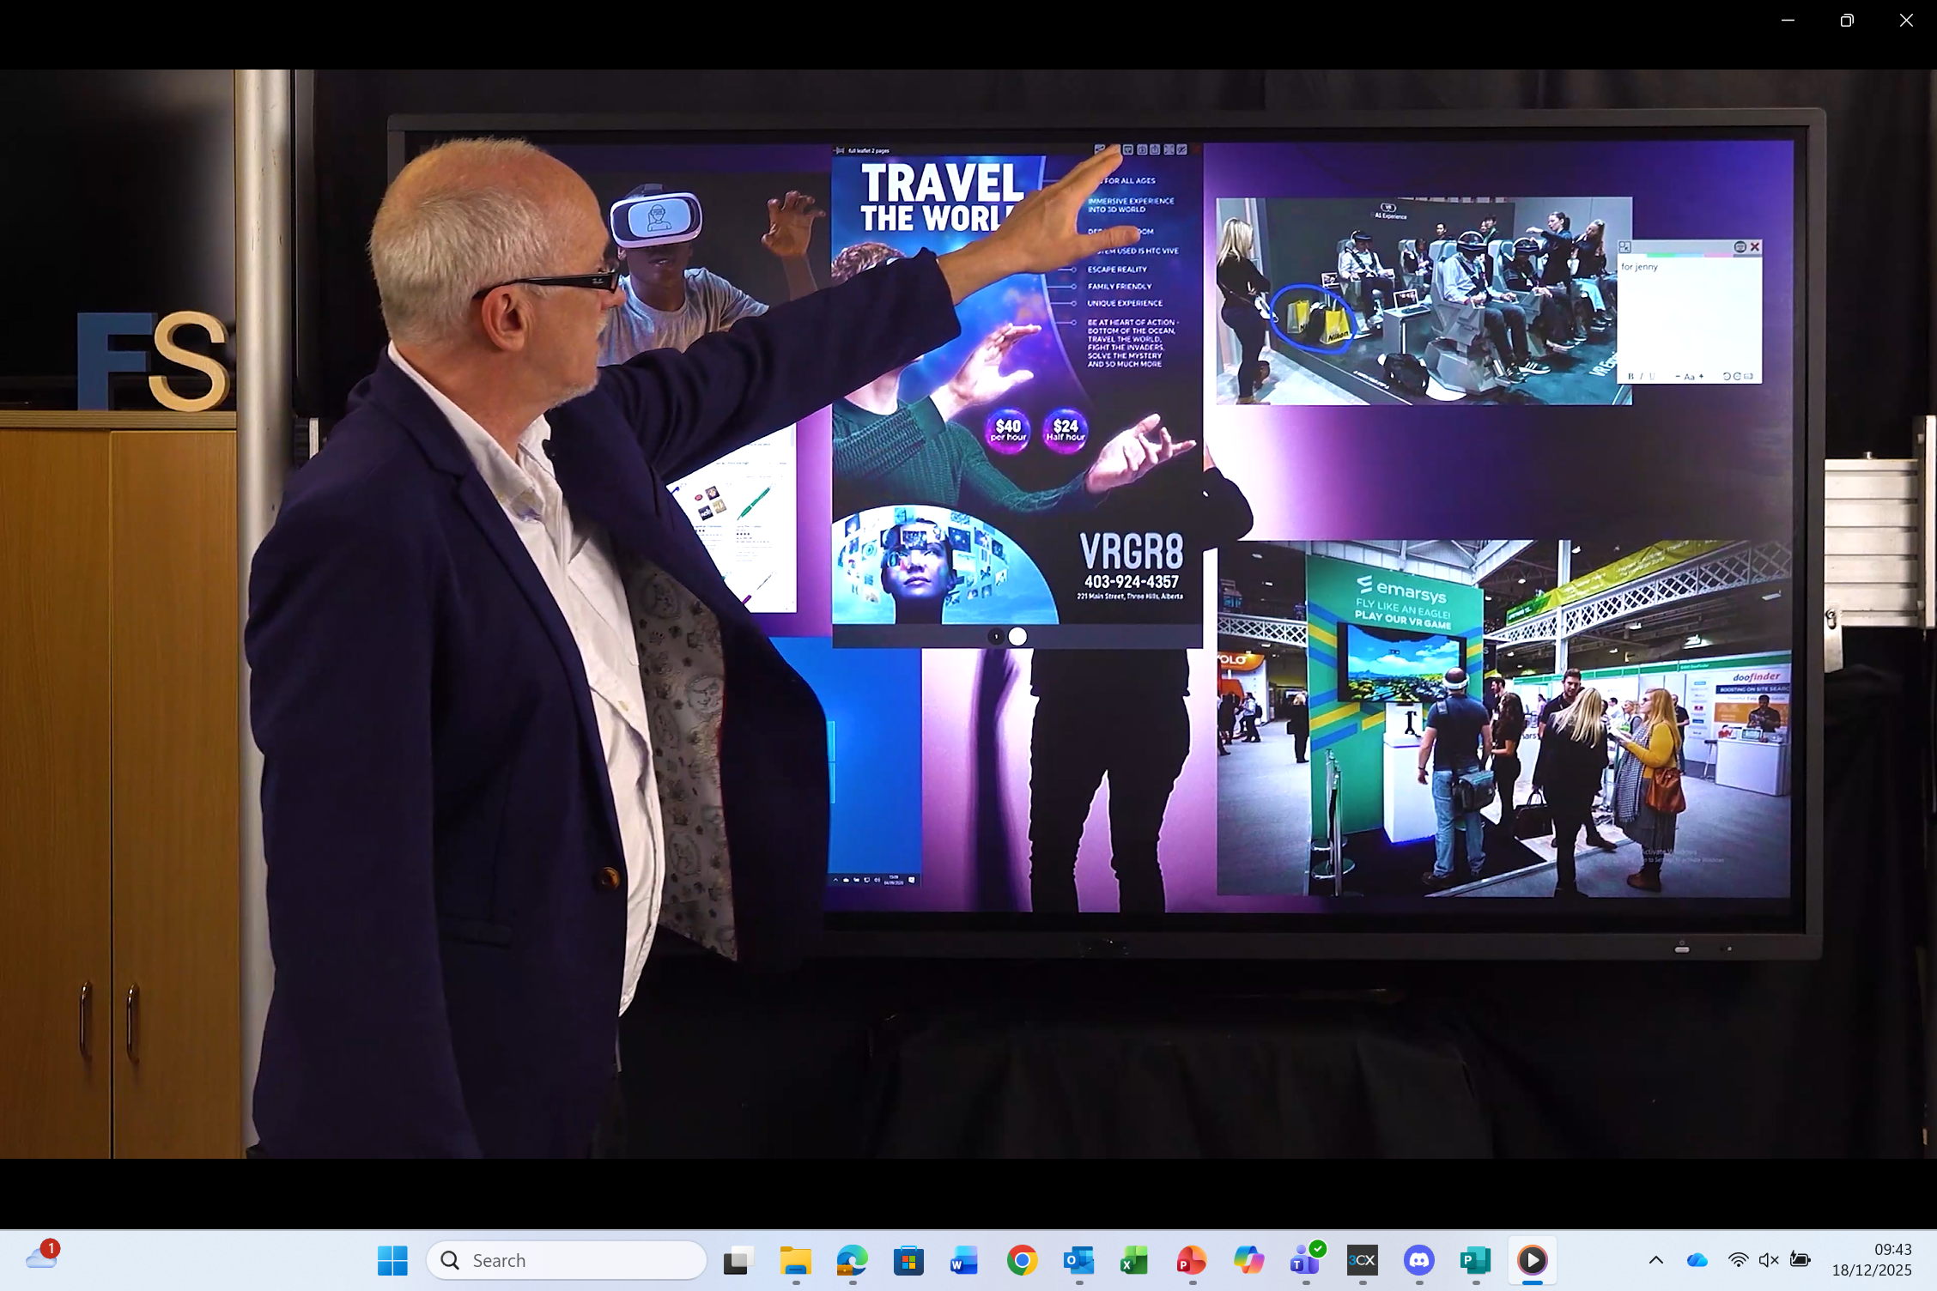

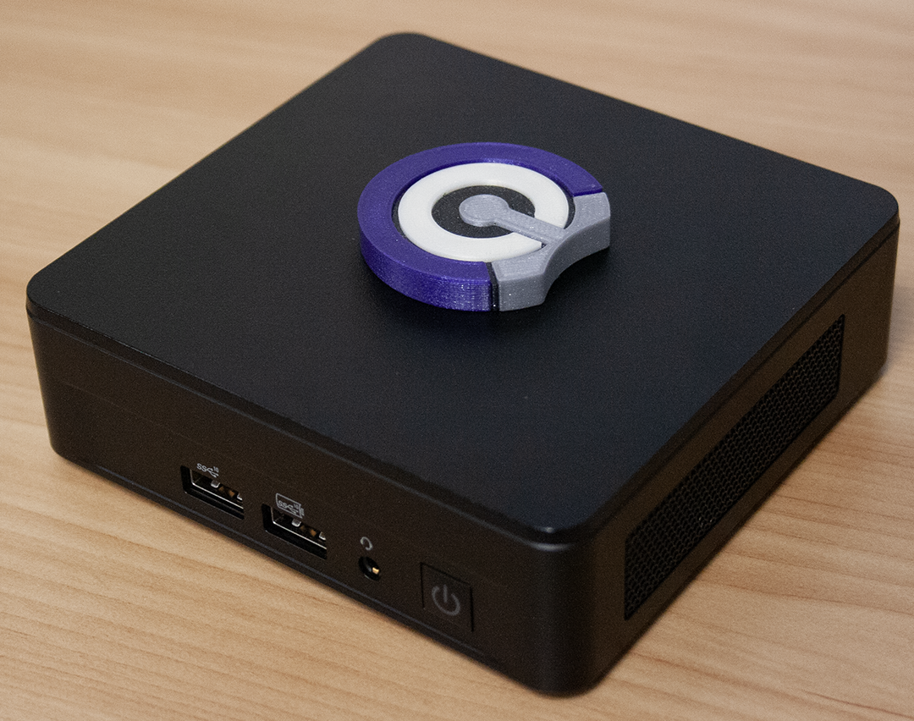
FUTURESoftware – OUR Products – COLL-IN
Collaboration Intelligently is the ideal collaborative presentation and workspace solution designed to enhance teamwork and communication.
Audiences today are looking to engage far more than just watching a presenter behind a podium with a clicker, they want to be engaged, absorbed into the presentation. Likewise, the presenter wants the same from the audience and to be fair this is very difficult from behind a podium.
Having the presenter move around a stage interacting with the presentation calling up multiple aspects of the presentation to highlight a detail, annotating, moving, resizing in front of the audience thus creating an experience and engagement like no other.
FUTURESoftware

Slide 6

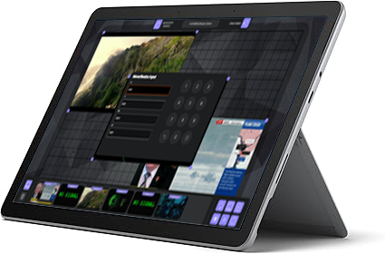


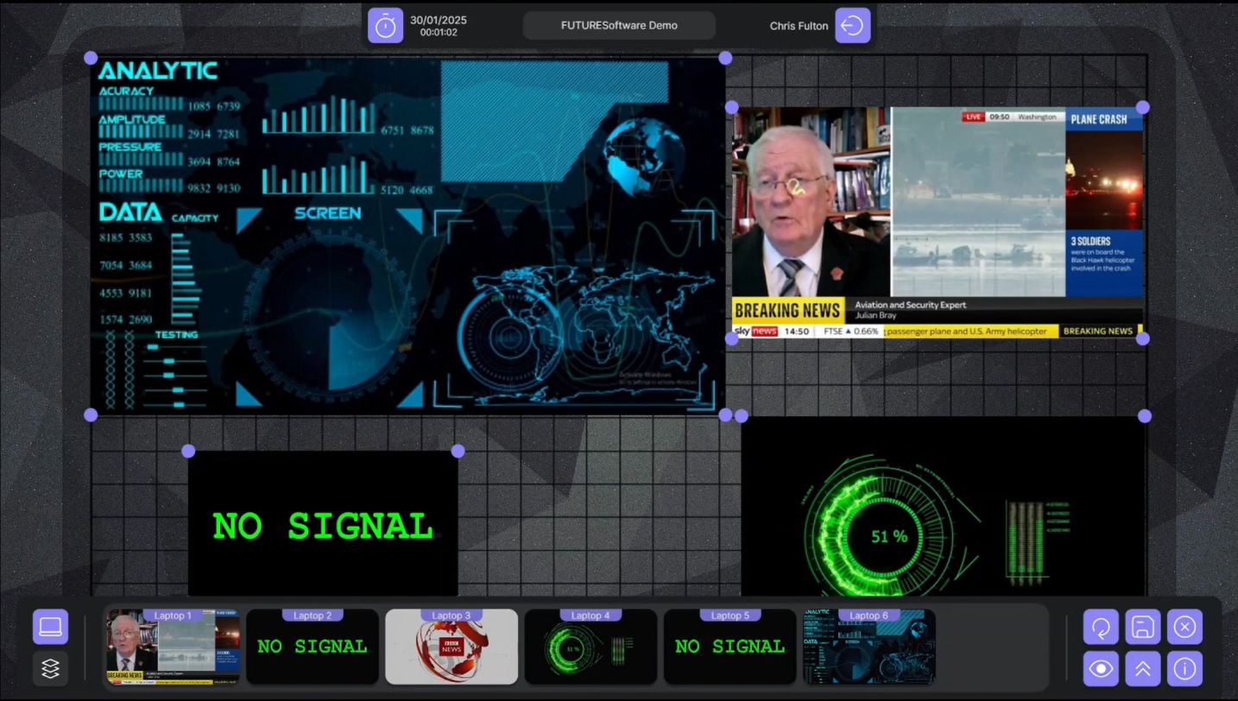
FUTURESoftware – OUR Products – PIPView Plus
This is the ultimate video and data wall controller, expertly designed to manage multiple video inputs and graphical outputs.
Perfect for large-scale video and data wall installations, it transforms complex environments into seamlessly integrated visual experiences.
Whether it’s meeting and board rooms, or monitoring and security applications, the PIPView+ delivers high performance and scalability for any scenario.
FUTURESoftware

Slide 7

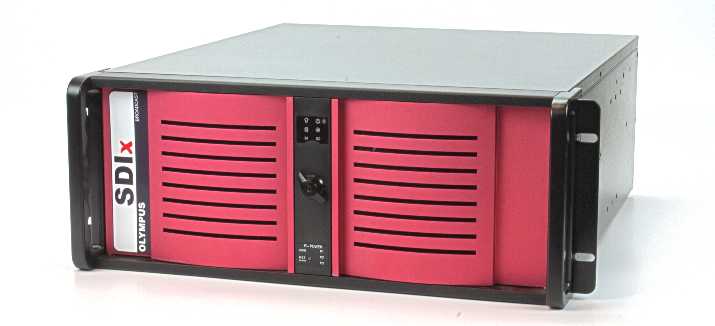
FUTURESoftware – OUR Products – SDIx
Designed to deliver uncompressed video in the highest possible formats, far beyond HD or 4K, SDIx solution ensures flawless playback with stunning smoothness and uncompromising visual fidelity, regardless of the display’s size, shape, or complexity.
Every frame captivates with precision and brilliance. Simplicity for everyone Operating the SDIx is simplicity itself. Its intuitive web interface allows users to drag and drop media, create and manage playlists, and schedule playback, no specialist training or technical expertise required.
FUTURESoftware

Slide 8
FUTURESoftware – Call to Action
FUTURESoftware is a software development company based in the UK with local software engineers and support
FUTURESoftware are adopting collaboration solutions for the educational sector via strong H/W partnerships
Invitation to collaborate on upcoming AV Projects
https://www.future-software.co.uk
https://www.coll-in.com
https://www.pipview.co.uk
https://www.sdix.tv
FUTURESoftware Ltd
Oakwood
Grove Business Park
Waltham Road White Waltham
Berkshire
SL6 3LW ENGLAND
Tel: +44 (0)1628 947 666
Email: sales@future-software.co.uk
Web: http://www.future-software.co.uk
Registered in England No. 3400689
VAT Registered GB 491 9282 12
FUTURESoftware

